Slide 1



WELCOME
30th Annual
Convention & Trade Show
#NARPM2018

Slide 3


Building a Killer Lease Agreement
Robert Locke
RMP, MPM
And Attorney
Monica Gilroy

Slide 4

Today’s Agenda
Big Picture
Things You NEVER Put in Your Lease
Things You ALWAYS Put in Your Lease
Notes:
4

Slide 5

Is the Landlord/Tenant Relationship So…..?

Slide 6

Adhesion
Contract
A contract between two parties with vastly different bargaining power.

Slide 7

Mortgage
Insurance contract
HOA documents
Home warranty
Rental car
Hospital admissions

Slide 8


Characteristics
Standard form boilerplate
Written & controlled by one party
No opportunity to negotiate
Customer must take it or leave it

Slide 10




Consumer protection laws written to prevent abuses
Courts scrutinize to prevent oppressive or unconscionable terms
Enforcement is questionable
Notes:
The challenge with Adhesion Contracts is that the courts know that
Those in power often abuse the public in the writing of these contracts
So …Click .. Consumer Protection laws are put in place to prevent abuses.
Click … Courts scrutinize to prevent oppressive or unconscionable terms
And …. Click …. enforcement is questionable
Click … now a lease clearly is an Adhesion contract
The owner has all the control
The tenant has to sign or walk away
And all the language is one-sided
If you’ve even wondered why judges ignore the terms of your lease in the courtroom
And lean in the tenants favor with their decisions, it’s because they understand that
It’s an Adhesion contract and the landlord wrote it in his favor… hoping he could enforce it.
You’d be making a mistake to think that … the tenant is an adult … so they should be
Held to what they sign … you’d be wrong. The courts understand this and whiled a big
Stick when it comes to forcing tenants to follow language that the landlord slipped into
The lease Hoping for a good outcome.
So, say all you want to say but understand that “thinking the tenant will be held to it is
Fantasy.”

Slide 11
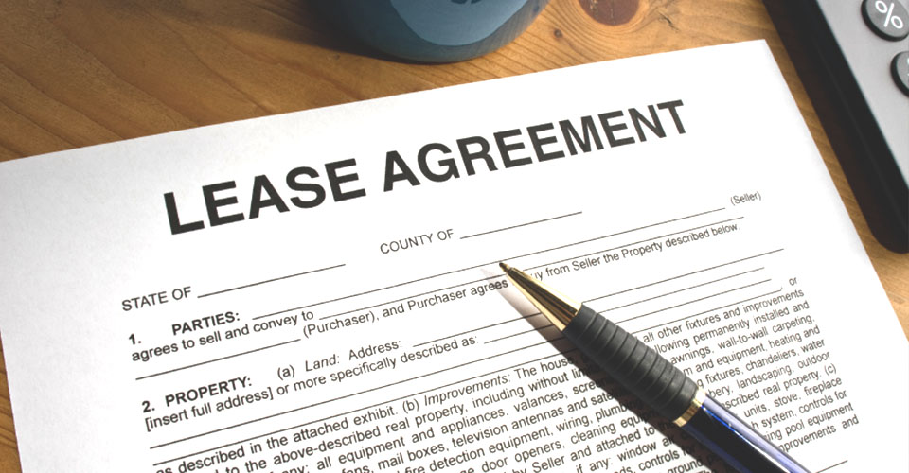
Adhesion
Contract

Slide 12
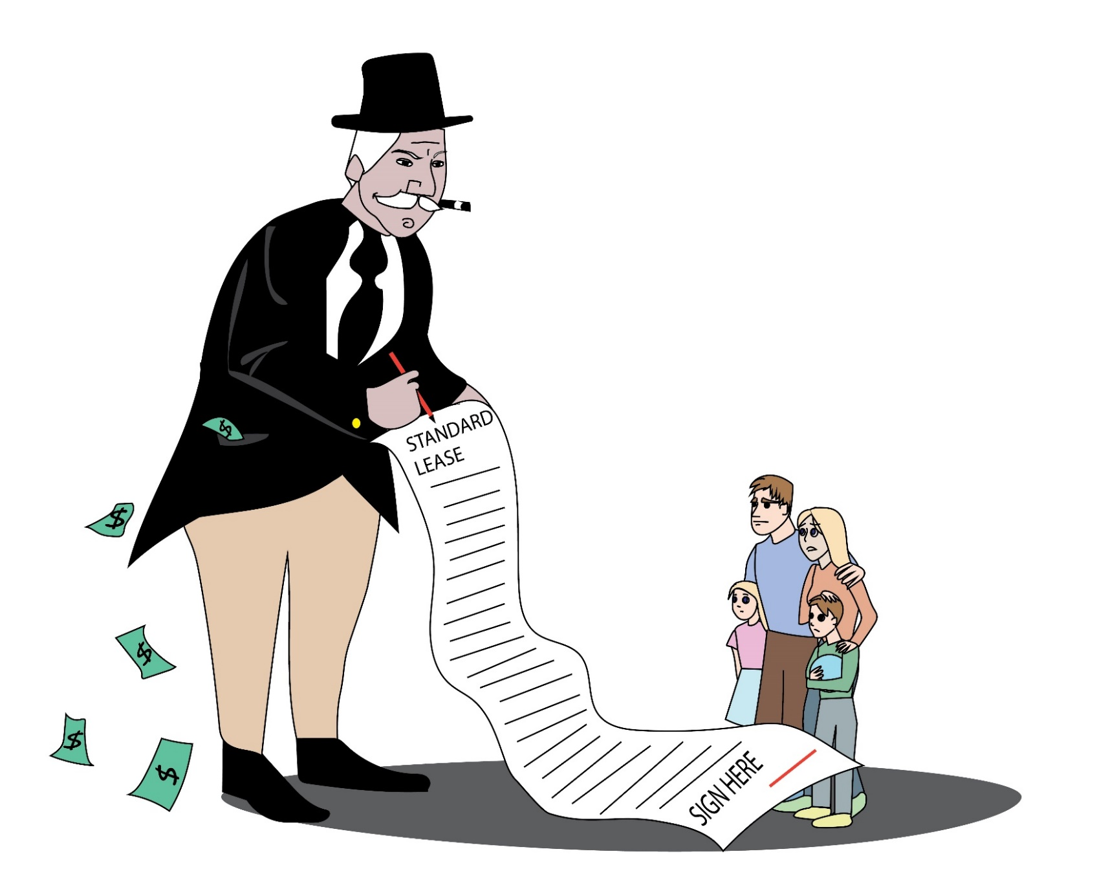
The Landlord has All the Power.
Notes:
Judges know that … Click … The landlord has all the power
Click .. The landlord has money to pay a hired gun to help him in his contractual position with the tenant
So judges naturally are out to protect the tenant from what landlords and their managers are trying to do to them.
Now, Landlords are not alone in these consumer protection laws
There are others in our society that are also under the protection of the courts for
These Out Of Balance .. One sided relationship
Click .. Now quickly go through the other relationships that need court protections

Slide 13
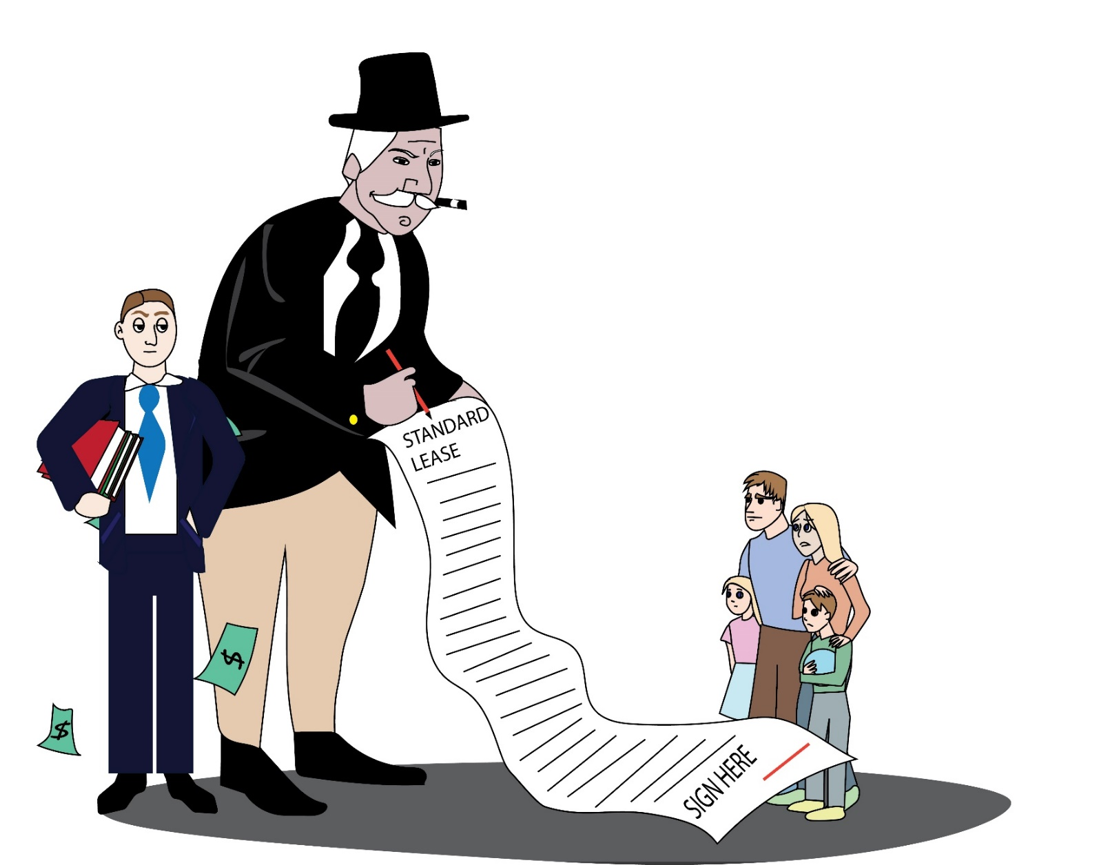
The Landlord Hires Help.

Slide 14


Doctor/Patient

Slide 15

Teacher/Student

Slide 16

Parent/Child

Slide 17

Employer/Employee

Slide 18


Lender/Borrower

Slide 19

Government Regulations
Laws designed to protect consumers from abuses by people who have undue power over others.
Notes:
So, click … Government Regs establishes laws designated to ….
And .. Click … the courts know that tenants need defending from landlords and
Their hired guns.
So stop putting things in your lease that you kind of know will give the judge
Heartburn when you get in court. It will work against you because the judge knows
There is no fairness in the lease .. It’s heavily weighted in the landlord favor and the
Judge see himself as the savior.

Slide 20
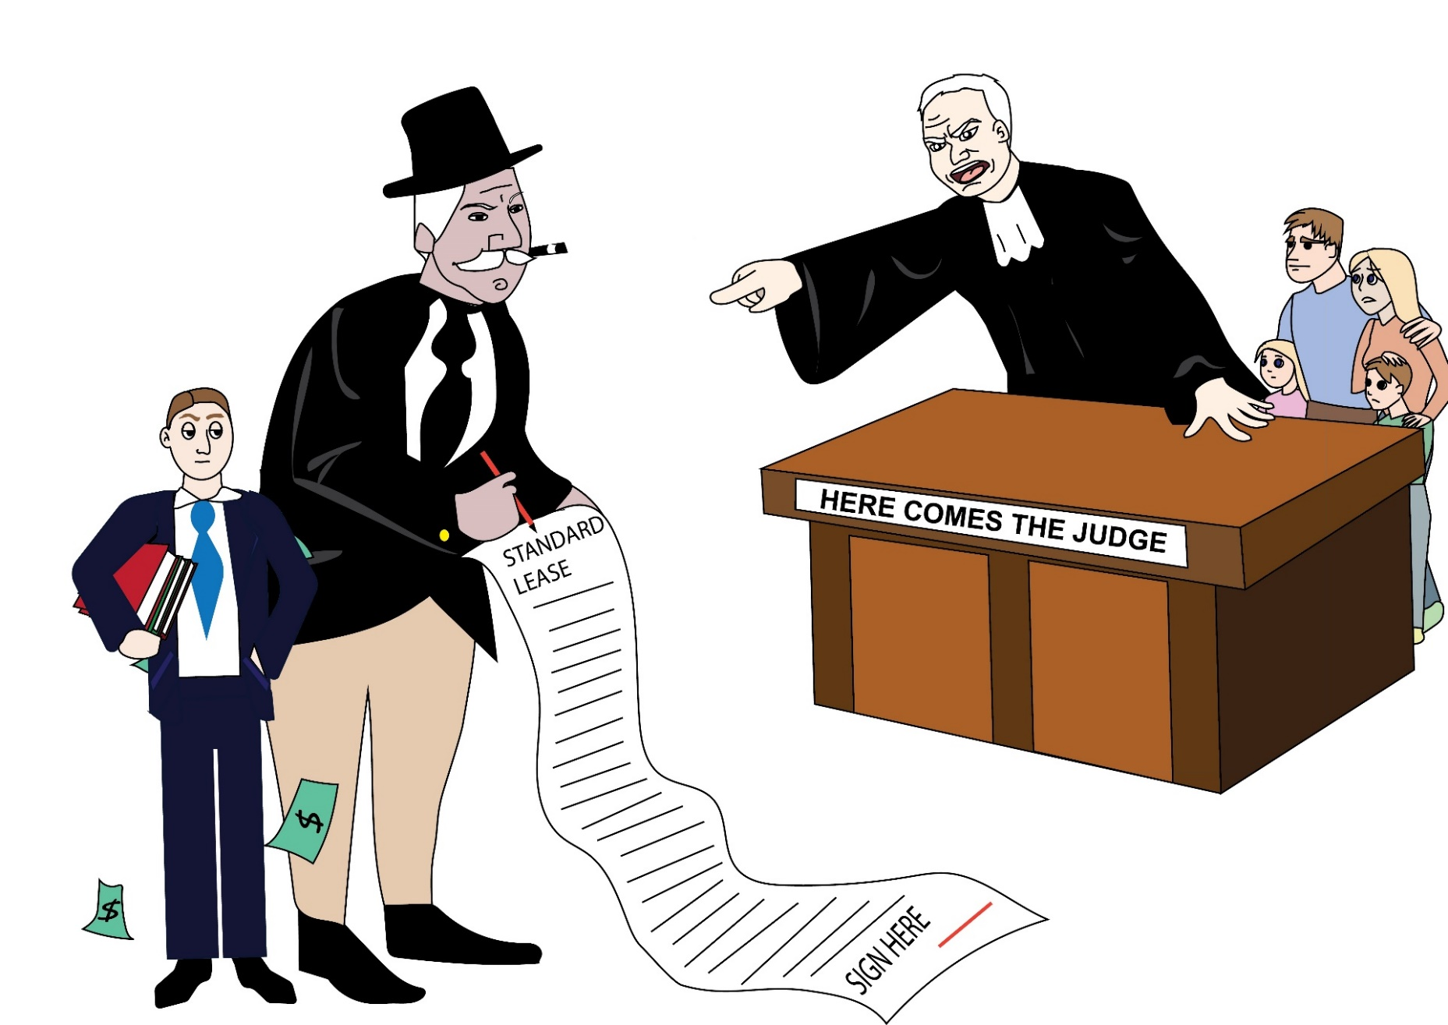
Courts Protect Tenants

Slide 22

2 Management
Styles
4 Lease
Configurations.

Slide 23

Broker Style
Duties
PMA
Manager
Lease Agreement
Landlord
Promises to Tenant
Owner
Tenant

Slide 24
Manager Style
Duties
PMA
Lease
Promises
Promises
Owner Manager Tenant

Slide 25
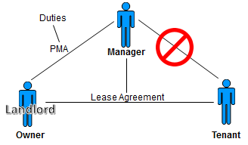
Broker Style
Promises
3 lease configurations

Slide 26
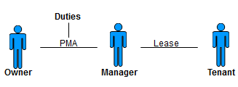
Manager Style
Promises
Promises
1 lease configuration

Slide 27

Broker Style
Owner signs the lease for self
Manager signs for company

Slide 28

Broker Style
Manager signs the lease FOR owner
Manager signs for company

Slide 29

Broker Style
Owner signs for self
Manager doesn’t sign.

Slide 30

Manager Style
Manager signs the lease for the company.

Slide 31

Conclusion
1. There are different ways to do leasing
2. Some are more scalable than others
3. You’ll evolve over time.

Slide 33
Things You NEVER Put in Your Lease
Notes:
OK
We’re moving on to the second section
Click .. Things you never put in your lease

Slide 34

#1
Things that Put the Tenant in Harm’s Way
Tenant agrees to:
Keep gutters clean
Climb ladders
Do all minor repairs
Pay the first $50 of all maintenance.
Notes:
Click .. Number 1 … Things that put the tenant in harms way.
It’s astounding to me what managers add to their leases w/out giving much Thought to the consequences. Here are examples of we to often see.
Click …. Tenant agrees to … Keep gutters clean … climb ladders
I’m not sure it’s a smart thing to demand the tenant be responsible for Either climbing on the roof or a ladder to clean gutters.
Tenants didn’t cause the leaves to clog up the gutters and I’m not sure You want to pay a defense attorney to defend that requirement when the
Tenant falls off and is injured … Think about the possible outcome of this kind Of language.
Click .. Tenant agrees to … Do all minor repairs or pay the first $50 of all maintenance
Some state laws allow landlord and tenant to negotiate minor repairs but that doesn’t mean You should press your tenant to replace the electrical outlet that’s sparking, or reach into the Garbage disposal. Think through the possible consequences of that and imagine what that
Lawsuit might look like when the watch maker comes out with one less finger.
Click .. Next slide … Tenant agrees to repair it if they broke it … or the sister language …
It wasn’t broken at move in so they must have broken it .. And should fix it. Sounds ok on the surface .. Be an adult .. Take responsibility for what you break .. I get it .. But as a practical matter Things Ware Out … seals deteriorate … mildew happens .. But judges don’t think tenants should do these repairs …. even if your lease says they will.
Sometimes there is a baseball size hole in the window and probably someone did it But demanding the tenant repair it isn’t the smartest way to handle it. If someone Comes home late after to much drinking and puts their shoulder into the door to
Get in … breaks the door frame and now you’re being called because the door Doesn’t lock. You can fold your arms and insist it wasn’t broken at move in but you Can‘t prove how it happened .. It doesn’t matter .. The judge is going to hold you Responsible for providing the tenant a safe place to keep their family so do the repair and argue later who’s going to pay for it.
To the judge .. Click .. Job 1 for the manager is the health and safety of the tenant
Now .. Click .. That may put you in conflict with the owner
But better off facing the owner than the judge.

Slide 35
#1
Things that Put the Tenant in Harm’s Way
Tenant agrees to do the repair if they broke it
If it wasn’t broken at move in, they must fix it.

Slide 36


#1
The health and safety of the resident
Potential conflict with owners
Face the owner vs face the judge.

Slide 37

#2
Things You Are Not Able (or Don’t Have a System in Place) to Monitor and Enforce
No pets over 10 pounds
Outside pets only
Pets on a leash
Change filters quarterly.

Slide 38

The Owner has the Right to Expect…
If it’s in the lease, it’s enforceable
You’re the professional, you should know
You wrote the lease terms
It’s your job to enforce the lease.

Slide 39
#2
Things You Are Not Able to (or Don’t Have a System in Place to) Monitor and Enforce
No guests over 10 days
Set temperature at 70
Mandatory renters insurance
No smoking
WHY?

Slide 40

contractualize what you can’t track or enforce!

Slide 41


Slide 42
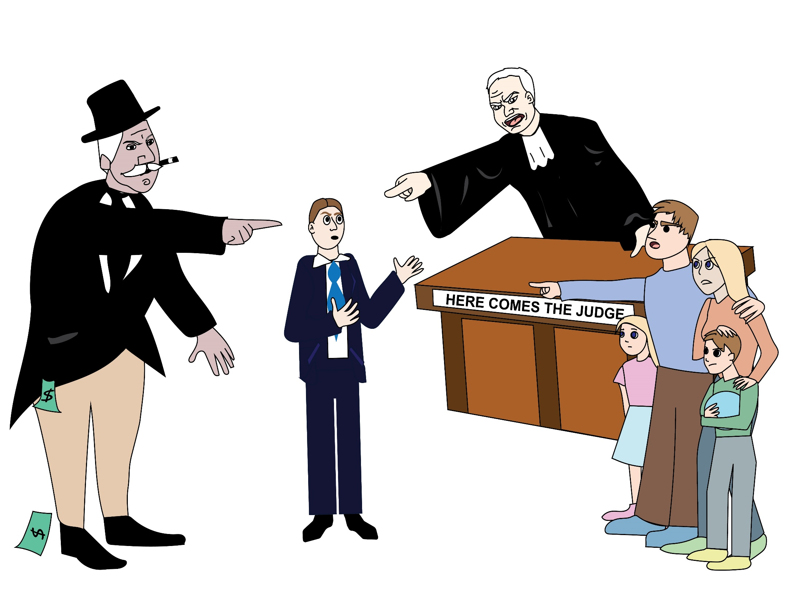

Slide 44

#3
Don’t Try to Bluff the Tenant Into Believing Things that aren’t True
“If tenant files Bankruptcy, the lease is void
and tenant agrees to vacate the property.”
Notes:
Click … Don’t try to Bluff …. Click …. It tenant files Bankruptcy ….
Believe it or not …. We found this in a State Association of Realtors Lease. You don’t have to be in real estate for more than a week to figure out that .. You Can’t Remove Peoples Rights Under Federal Law With Language In A Contract. It would be like saying … If Manager committed a fair housing violation tenant agrees not to file a claim. Nonsense. Judges kneejerk then they see this stuff and everything goes south from then on.
Stop trying to smoke the tenant .. It’s an Adhesion Contract .. Stop doing stupid w this kind of language.
Here are some other examples … Click .. If title changes the lease of void …. Nonsense … leases are title rights … so changes in title don’t void a lease … even if the lease says so.
Here’s another one .. Click … IF the tenant does .. So-and-so .. They automatically forfeit their security deposit. … you can put that kind of stuff in the lease but it won’t hold up …. and judges get cranky when they see that stuff. There is a default process you must go through to abscond with the tenants deposit … but it needs to include a written notice .. A right to cure … but AUTOMATICALLY FORFET isn’t the way to do it.
Remember this … Click .. Just because you say it .. Doesn’t make it true … Don’t believe the baloney that .. The tenant is an adult and should be held to what they sign … that thinking doesn’t apply to Adhesion Contracts.

Slide 45
#3
Don’t Try to Bluff the Tenant Into Believing Things that aren’t True
If title changes, the lease is void
If tenant… they automatically forfeit the security deposit.

Slide 46

Just because
you say it
doesn’t make it true!

Slide 47

#4
Be Fair to Both Parties
“If resident breaches the lease, resident agrees to pay management’s attorney fees
If management breaches the lease, management agrees to pay $1.”
Notes:
Number 4 .. Click … Be Fair to Both Parties
We said this earlier … Judges are looking for FAIRNESS in Adhesion Contract. When the one writhing the contract goes overboard judges react in ways landlords won’t like very much. Here’s a common stip in most leases.
Click …If the resident breaches the lease ……. Now that would be ok if the same was true on the landlords side .. But what we saw recently from one large brokerage firm was this language ….. Click … If management breaches ….. . It doesn’t take a rocket scientist to figure out that this kind of effort to smoke the tenant is greatly fronded upon by the courts and they are likely to react in a retaliatory way in the tenants favor and rule way beyond what the landlord would have felt if they had been fair in their language.
Click …. In the courtroom opposing council and judge use language like this …. Click … Unconscionable …click … Egregious …click … Against Public Policy
You don’t want them to be using this kind of language about Your Lease … so Be Fair To All Parties …. Write this language in a way that your attorney can defend it in front of the judge.

Slide 48

Unconscionable
Egregious
Against
Public Policy

Slide 50

#5
Things that Move
Staff names
Email addresses
Phone numbers
Methods of paying rent
Operational issues
WHY?
It’s going to change.

Slide 51

#6
Stop Attaching
Exhibits
Lead paint disclosure
Move-in inspection
Applications
Tenant handbook
House rules
Harder to defend.
Notes:
Number 6 … Click … Stop Attaching Stuff
On of the challenges defense lawyers have defending property managers is going into a courtroom defending a 40 page document made up of a 10 page lease with 6 …. Click …. Exhibits …. A … click … lead paint disclosure … a…. click …. Move in inspection and application .. A .. Click … tenant handbook …and three pages of … click … house rules …. All attached hereto and made a part of the agreement by reference.
This creates a hugh challenge because opposing council always attacks your documents first .. Then moves on to the real issue … Mold, Rodents, repairs .. Whatever it is you’re fighting about. It’s almost impossible to defend 40 pages without finding inconsistencies, conflicts in language, things that are unclear …. You just make your lease .. Click … harder to defend. …. Attorneys want SIMPLE, CLEAN, SHORT .. And the more you add to it the harder it is to defend … so .. Click … STOP CONTRACTUALIZING EVERYTHING.

Slide 52

Contractualizing
Everything

Slide 53

#7
Don’t Use Lease as a Data-Dispensing Form
Utilities
HOA contact
Rent payment methods
Staff phones
Eviction process.

Slide 54


#8
Signature Page Madness
Notes:
Number 8 … Click … Signature Page Madness
One of the challenges property managers have is that we get many of our documents

Slide 55
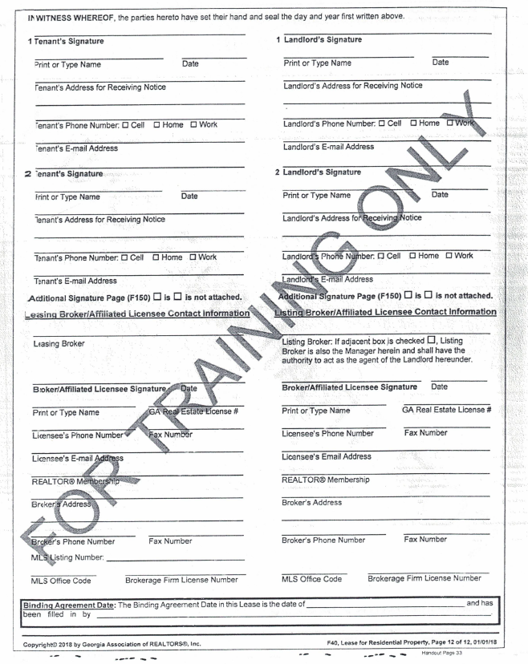

Slide 56
#8
Signature Page Madness
Data collection
Emails
Phone numbers
Co-oping agent
Use housekeeping
Simple signature page.

Slide 57
IN WITNESS WHEREOF, the parties have executed this AGREEMENT THIS _____ DAY OF ____________________, 20______.
America’s Best Manager Resident(s)
By: X
its Print Name
X
Print Name

Slide 58
#8
Signature Page Madness
Structure your signature page to work 90% of your owner profiles.

Slide 59
Contractualizing
Everything

Slide 61
Things You ALWAYS Put in Your Lease

Slide 62

Mirror Your Landlord Tenant Law
When you take the security deposit
Move-in inspection
Duty to repair
Timely move-out inspection
Return deposit
Eviction process.

Slide 63

But I’ve been doing this for 10 years!
Don’t count on that argument.
Notes:
63

Slide 64

Manage Your Labels
Owner’s name (hereinafter “Owner”/Landlord)
Manager’s name (hereinafter “Manager”/Broker/Agent)
Property address (hereinafter “Property”/”Premises”)
Be consistent.

Slide 65

Make a Case
NOT using the label “Agent” or “Broker” to identify yourself in your property management agreement or lease.

Slide 66


We all interpret words from past experiences
Abortion
NRA
Terrorist
Immigrant
Agent/broker.

Slide 67
What do we know about
the public perception of
Agent or Broker?
Assistant, scribe
Make NO decisions
Spend NO money.

Slide 68
We create confusion with our labels
Confusion leads to litigation.

Slide 69
Property
management
is different
than sales
So let’s use
different labels.

Slide 70
Using “Manager”
forces readers to examine the document to figure out what authority the Manager has.

Slide 72

About Early
Move Ins
Start date and move in date don’t have to match
Set the rent start date.

Slide 73
About Early
Move Ins
Encourage them to take possession early
Makes preparing leases easier
Prorate rent?

Slide 74
About Early
Move Ins
If the owner asks
Vacant houses invite vandalism
Gets the tenant more fully committed
Lawn care and utilities.

Slide 75

Set Up for Auto Renewal
Silence always creates confusion
If neither party notifies the other
Resist MTM
Consider a 5-year lease
Stop resigning leases.

Slide 76

Current Revenue and Company Value is Affected
Long-term occupants make you money
Set up your lease to keep them there
Reduces labor
Keeps owners.

Slide 78

Entire Agreement
This Agreement, plus Exhibits and Addendums executed by the parties from time to time, constitutes the entire Agreement between the parties
and no oral statements, flyers, website copy, advertisements, brochures, property flyers, emails, texts, company handbooks, policies or representations shall be binding on either party and are not part of this Agreement.

Slide 79
Entire Agreement
Four Corners Language
You defeat this protection by adding special stipulations, exhibits, handbooks and policies.

Slide 80

Exculpatory Language
Indemnify
Hold harmless
Agreement not to sue
Limits on damages
Body Armor
CYA.

Slide 82


Use Fines and Fees to Promote Good Behavior
Stand up’s
Presence required at property visits
Changing locks
Unauthorized pets
Utilities off.

Slide 83

Mirror your landlord tenant law
Be consistent with labels
Use Manager and not Agent/Broker
Allow early move ins
Set up for auto renewal
Don’t add exhibits or handbooks.

Slide 84
Robert@
TrainingPropertyManagers.com
Monica.Gilroy@
GilroyFirm.com
TrainingPropertyManagers.com/ SanDiego2018

Slide 85
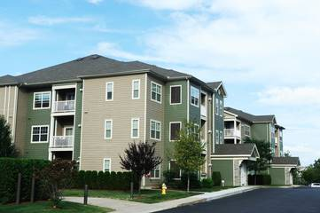
The apartment industry taught me this.

Slide 86

I Love
My
Rental Property
Notes:
86

Slide 87

A Vacant Property
is a
Money Pit
Notes:
87

Slide 88

The Tenant
is the
Asset
Notes:
88

Slide 89

It Changes the Way You Think
There’s NO MONEY in procurement fees
Long-term tenants make you money
Affects your attitude
Affects the renewal process.

Slide 90
Conclusion
Change your thinking about tenants and you’ll make more money AND make your business more valuable.

Slide 91
Mirror your landlord tenant law
Be consistent with labels
Use Manager and not Agent/Broker
Allow early move ins
Set up for auto renewal
Don’t add exhibits or handbooks.

Slide 92
Robert@
TrainingPropertyManagers.com
Monica.Gilroy@
GilroyFirm.com
TrainingPropertyManagers.com/ SanDiego2018

